Slide 1
Finding Your Footing
2
A 6 week guide for late diagnosed autistic adults. Diagnosis

Slide 2
Who we are.
Adrian Walsh – Late Diagnosed autistic.
Luis Ordaz - Chartered Clinical Psychologist.
Joshua Brien - Recovery Hub Coordinator

Slide 3
Ground Rules
What's said in this room stays in this room - please don't share anyone else's story outside this group, even anonymized.
This isn't therapy, and I'm not here to diagnose or treat anyone - think of it as a structured space to process and build some practical tools together.
You're free to step away at any point - without needing to explain why
Passing is always fine - you're never required to speak more than you want to
Disagreement is fine; put-downs aren’t - It is completely okay when people see things differently, but personal attacks and insults have no place in a healthy conversation
We aim to start and finish on time. -

Slide 4
Relief & Grief
A lot of late-diagnosed autistic adults describe two feelings arriving at once: relief at finally having language for things you've experienced your whole life, and grief — for the years spent without that language, for the self-blame, for things that might have gone differently with earlier support. Both of these are completely normal, and you don't have to resolve them into one tidy feeling.
There are some patterns worth naming, because a lot of people in a late-diagnosed group will recognize themselves in at least one: being diagnosed only after your own child was diagnosed and you started recognizing yourself in their assessment; being missed for years because autism can present differently in women and in people who were socialized to mask heavily; or spending years with a different diagnosis first — anxiety, depression, OCD, or a personality disorder — that explained some symptoms but never quite the whole picture.
It's also common to get stuck somewhere in this process — a family member who dismisses the diagnosis, self-doubt about whether you're 'autistic enough,' or grief that it wasn't caught sooner. We'll come back to that later in the session

Slide 5
Q&A
Q: What is a late autism diagnosis?
A: A late autism diagnosis occurs when an individual is diagnosed with Autism Spectrum Disorder (ASD) in their late teens or adulthood rather than during childhood. Many people with ASD—especially women—go undiagnosed due to masking behaviours or misconceptions about how autism presents in different individuals.
Q: Why do some people receive an autism diagnosis later in life?
A: There are many reasons why autism might go undiagnosed until adulthood. Some of the main ones include masking, misdiagnosis, lack of awareness, or a person having milder symptoms.
Q: What are the signs of autism in adults?
A: An autistic adult may have difficulties with social interactions, maintaining relationships, or understanding social cues. They may also have sensory sensitivities, thrive on routines, and struggle with changes. Some may show signs of communication difficulties, high levels of social anxiety, or have intense focus on specific topics.
Q: What challenges do people with a late autism diagnosis face?
A: Before the diagnosis, autistic adults may struggle with feeling different, maintaining relationships, exhaustion due to masking, anxiety, depression, and more. Some may even experience psychosomatic symptoms due to stress, such as headaches, stomach issues, or chronic fatigue.
Q: How does autism present differently in women compared to men?
A: Compared to men with autism, autistic women may be able to blend in better, have stronger emotional intelligence, or engage in more socially acceptable special interests. They may also have stronger internalized struggles, leading to anxiety, depression, or eating disorders. Because of this, many women remain undiagnosed or are misdiagnosed with other conditions like borderline personality disorder, ADHD, and more.
Q: Can a late autism diagnosis improve quality of life?
A: Many individuals experience significant relief after being diagnosed. They report understanding past struggles and reduced feelings of guilt or self-doubt. Many get access to tailored therapies, the right coping strategies, and support networks that help them thrive and develop a healthier sense of identity.

Slide 6
Reframing Exercise
choose 2–3 memories from childhood, school, or early adulthood where they felt "different" or were criticized for a trait
For each memory, you write:
  What actually happened, in a sentence or two.
  How it was explained or labelled at the time (e.g., "lazy," "shy," "dramatic," "too sensitive").
  How you might understand it now, through what you know about autism.
Write a short letter to your younger self. Use the yellow pads and write a letter that you think will help your younger self deal with what is to come.

Slide 7
Dear younger me,
You are not broken. You are just trying to live in a world that was not built for your brain.
I know you feel like you are doing it all wrong. You feel too loud, too quiet, or too sensitive. You spend every day copying the people around you just to fit in. That is called masking, and it is exhausting.
Please stop forcing yourself to be normal. Your quirks and your deep interests are not flaws. They are who you are. Here is what I want you to know:
You are autistic. Your brain processes sights, sounds, and feelings differently than most. That makes everyday life harder, but it also gives you a unique view of the world.
It is okay to rest. When the noise and lights get to be too much, you are allowed to step away. You do not have to push through the pain to prove your worth.
Find your people. One day, you will meet others who speak your language and share your passions. They will not ask you to change.
Be kind to yourself. Give yourself the same patience and love that you give to others.
You are going to survive the hard days. More than that, you are going to find a life where you feel safe, understood, and genuinely happy to be yourself.
With so much love,
Your older self

Slide 8
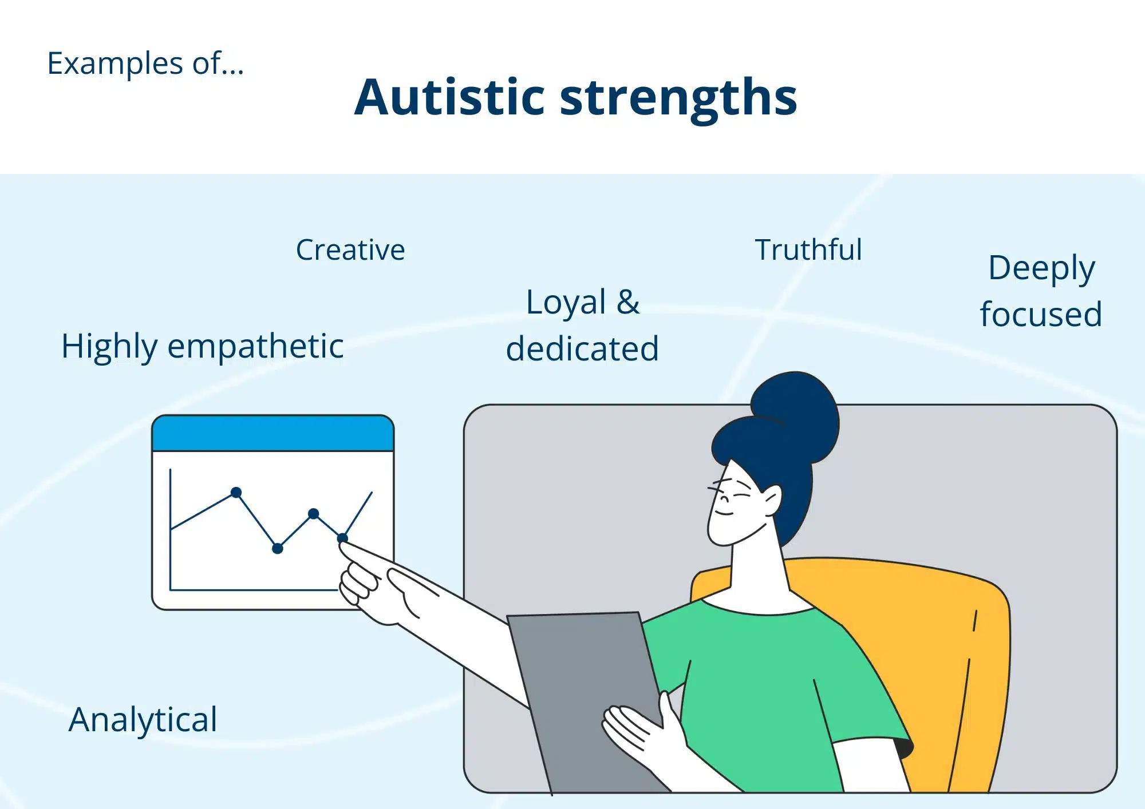

Slide 9
Late Diagnosed strengths
A late autism diagnosis reveals unique cognitive, creative, and interpersonal strengths that have often been honed through years of navigating the world without a roadmap.
Cognitive & Problem-Solving Strengths
Hyperfocus and Deep Expertise: The ability to immerse oneself completely in specialized subjects, leading to expert-level knowledge and high productivity during flow states.
Pattern Recognition: A natural talent for spotting trends, system flaws, or hidden structures in chaotic environments that others often miss.
Attention to Detail: Exceptional observational skills that ensure high precision and accuracy in professional and technical tasks.
Unconventional Thinking: Lateral, non-linear problem-solving perspectives that break through impasses with ingenious, out-of-the-box solutions.
Character & Interpersonal Strengths
Radical Honesty & Integrity: A deep-rooted moral compass and a strong, uncompromising sense of justice and fairness.
Authenticity & Loyalty: Fiercely dependable relationships with a refreshing disinterest in office politics or superficial gossip.
Reframing & Self-Awareness: Late-diagnosed adults often develop profound resilience, deep self-reflection, and the capacity to view their past with newfound self-compassion

Slide 10
Disbelief of diagnosis
Why Families or Friends Disbelieve a Late Diagnosis
Outdated Stereotypes: Many people only picture severe, highly visible childhood presentations of autism, failing to understand internal struggles, high-masking traits, or different presentations in adults.
Defensiveness and Guilt: Parents may view your diagnosis as an indirect criticism of their parenting, leading them to deny it rather than face the reality and guilt that you struggled unsupported.
Implicit Genetic Mirroring: Autism is strongly genetic. Family members may deny your traits because they see the exact same behaviours in themselves and assume "that's just how everyone is" or how your family operates.
Dismissal of Internal Experience: Because you managed to survive, work, or school without an early label, they may treat your current accommodation needs as dramatic or unnecessary.
Practical Ways to Handle Disbelief
Stop Trying to Convince Them: You do not need your friends or family's permission or validation to be autistic. Acceptance from yourself and your community matters more than changing a closed-minded view.
Set Firm Boundaries: Tell them plainly: "This diagnosis is professional, accurate, and final. I am not open to debating it." If they continue to mock or dismiss you, limit the personal information you share with them.
Shift to Behaviour Over Labels: Instead of arguing about the word "autism," focus on concrete needs. Say "I need a quiet room for twenty minutes" or "I cannot handle loud environments" rather than explaining the neurological mechanics behind it.
Seek External Validation: Lean on peer-support spaces, online neurodivergent communities, or a therapist who specializes in neurodiversity to process the grief of being misunderstood by your relatives.

Slide 11
Crisis Support
Jersey Mental Health Crisis Line: Call 01534 445290
Out-of-Hours GP Service: Call 01534 444545
Samaritans of Jersey Call 116 123
Listening Lounge Call 01534 866793
Mind Jersey Call 0800 7359404
If you or someone you know is in immediate danger or needs urgent medical attention, Call 999 or go straight to the Emergency Department at Jersey General Hospital.

