Slide 1
Finding Your Footing
4
A 6 week guide for late diagnosed autistic adults. Burnout

Slide 2
Who we are.
Adrian Walsh – Late Diagnosed autistic.
Luis Ordaz - Chartered Clinical Psychologist.
Joshua Brien - Recovery Hub Coordinator

Slide 3
Ground Rules
What's said in this room stays in this room - please don't share anyone else's story outside this group, even anonymized.
This is therapeutic but not therapy - think of it as a structured space to process and build some practical tools together.
You're free to step away at any point - without needing to explain why
Passing is always fine - you're never required to speak more than you want to
Disagreement is fine; put-downs aren’t - It is completely okay when people see things differently, but personal attacks and insults have no place in a healthy conversation
We aim to start and finish on time. -

Slide 4
Autistic burnout is when:
The demands of life exceed the mental or physical energy you have to deal with them.
As you try to cope with this, your energy depletes, and your body struggles to manage things that you may usually find easy.
The demands may be too much and you may not have support to cope with the demands, resulting in higher levels of stress.
Because you do not have the energy to manage the situation, you need time/ space/ tools to recover your energy. But if you are unable to get the opportunity to properly recover, your energy reaches 0, and you are in burnout.

Slide 5
Signs of burnout include:
You may find it harder or more overwhelming to do everyday things that you used to find easy (e.g., washing, dressing, sorting and tidying, preparing snacks).
You may be more forgetful and have difficulty remembering things people have told you, this can be really frustrating!
It may be harder to make choices, such as choosing what to eat, watch on TV or what to wear.
You may find sensory things such as different sounds / sights / smells / tastes / textures around you and the need for different movements either increased or decreased
You may feel a lot more anxious than usual. This can also make you experience more headaches, tummy aches or other physical symptoms.

Slide 6
Signs of burnout include:
You may feel constantly exhausted, or you may feel a bit like you have too much energy and feel restless and agitated.
Your sleep and diet may be affected, you may find that you are eating / sleeping more or less than usual.
You may be more emotional, more anxious, more tearful or angry but not really able to understand why.
You may struggle to see your friends as much. You may want to stay at home much more and feel unable to go out, including struggling to leave your room.
You may find that you need to work harder to focus on one thing at a time, you may feel like you want to spend all your time with your special interests to help you manage, or you may lose interest in everything you once enjoyed as you feel too depressed and tired.

Slide 7

It is important to note that burnout may look similar to depression, but is different (and can occur at the same time)

Slide 8
Meltdown vs. Shutdown
Feature | Meltdown | Shutdown
Primary Direction | Outward / External | Inward / Internal
Nervous System State | Hyperarousal (Fight or Flight) | Hypoarousal (Freeze)
Energy Level | Intense surge or eruption | Collapse or intense fatigue
Common Behaviors | Crying, yelling, pacing, rocking, throwing or hitting objects, urgent need to escape | Silence, stillness, blank expressions, withdrawal, dissociation, curling up.
Speech Ability | Loud, fragmented, or highly repetitive speech | Situational mutism; completely unable to speak or process instructions
How It's Misread | As a "temper tantrum," anger, or poor behavior | As rudeness, laziness, sulking, or compliance
Immediate Need | Space, physical safety, and removal of triggers | Quiet, low-demand environment to reset

Slide 9
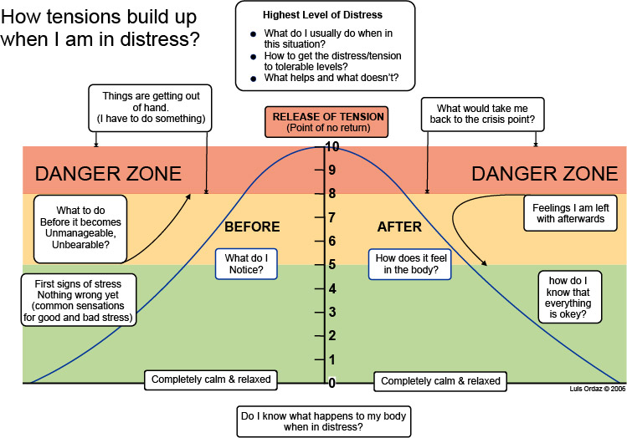

Slide 10
Building a personal early-warning radar
Part 1
Read the grey examples first. They are prompts only, and your own normal may look completely different.
Pick an "okay day". It should be a recent, typical day when you weren't overwhelmed, not their best day or their worst. If you are in a rough patch now, you should think back to when things felt manageable, such as a few months ago, and write that down.
Work down the table one row at a time. A few words per row is enough, and rough answers are fine. For the meltdowns row, you only need to say roughly how often these happen.
Skip any row that is hard to answer. A blank row is fine, and they can come back to it later.
Stop at the end of the table. Nothing is shared, and you don't need to look at the other pages yet.

Slide 11
Building a personal early-warning radar
Part 2
Re-read the baseline for a minute. This re-anchors you after the break, because every tick in Part 2 is measured against it.
Go through the checklist one category at a time. For each statement ask: "Is this different from my baseline over the last couple of weeks?" Tick it only if it is a change, not if it is sometimes true.
Skip anything that doesn't fit. Nobody will have every sign.
Add your own signs in the space provided. Personal signs are often the most reliable ones.
Count the ticks and write the number in the box. Then read the short guide beside it and tick how long they have noticed the changes. One or two ticks means keep an eye on things. Three or more, or anything getting steadily worse, means move on to Part 5.

Slide 12
Building a personal early-warning radar
Take-home: Parts 3 to 5
Part 3, weekly tracker (2 minutes a week). Write the week's start date in the first column. For each of the five areas give a score: 0 for the same as baseline, 1 for a bit harder, 2 for much harder. As a guide, the ticks in each Part 2 category can seed Week 1 straight away. Then add up the total and note any big demands that week. The trend over two or three weeks matters more than any single score.

Slide 13
Building a personal early-warning radar
Take-home: Parts 3 to 5
Part 4, load map (10 minutes, once). For each row circle the load level and whether it can come down, then write one small change. Finish by choosing the single thing you could reduce this week. The aim is to find one thing, not to fix everything

Slide 14
Building a personal early-warning radar
Take-home: Parts 3 to 5
Part 5, response plan (15 minutes, once). In the amber box tick what would help you and pick your top three for this week. The red box is best filled in with someone who knows you well: what helps, what makes things worse, which demands you can pause, who you will tell, and your own version of the ready-made message. Also add a support contact. The finished page needs to be somewhere you will actually see it, such as a photo on your phone or a copy on the fridge.

Slide 15
Crisis Support
Jersey Mental Health Crisis Line: Call 01534 445290
Out-of-Hours GP Service: Call 01534 444545
Samaritans of Jersey Call 116 123
Listening Lounge Call 01534 866793
Mind Jersey Call 0800 7359404
If you or someone you know is in immediate danger or needs urgent medical attention, Call 999 or go straight to the Emergency Department at Jersey General Hospital.

